Slide 1
SIMPSON CHARACTER PREDICTION
PROJECT MEMBERS - GUIDES:
THE SIMPSONS
TANMAYA SAHU Prashant Sir
RISHAV MITTAL
BIPUL SUMAN
Nidhi ma’am

Slide 2
Why this project?
As a big Simpsons fan, I have watched a lot (and still watching) of The Simpson episodes -multiple times each- over the years. I wanted to build a neural network which can recognize characters.

Slide 3
About this Dataset
The dataset is already available on Kaggle and still growing ,as the characters are being manually labelled.The dataset was manipulated it for the best results pulling out some characters & create a new test base coming of training base, because the test base is unsellfull for this application.The data on Kaggle contains 20 classes(characters).

Slide 4
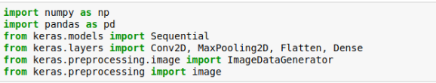
Libraries used for Pre-Processing

Slide 5
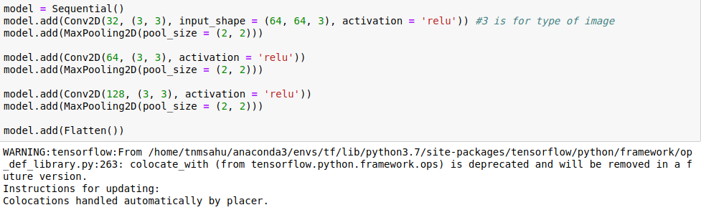
Applying Model
INPUT LAYERS-

Slide 6
OUTPUT LAYERS-
For the output layers we will adding a Dense layer with 64 neurons and other with 20 neurons (number of characters). The first will still have the ReLu activation function and the second have had the softmax activation function.We use categorical_crossentropy for multiple outputs(different characters) and to finalize we use the metrics accuracy to multiple outputs.

Slide 7
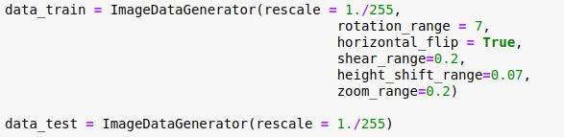
Loading the Dataset-
As we don’t have a huge data set, we are using data augmentation . It means doing a number of random variations over the pictures so the model never see the same picture twice. This helps prevent overfitting and helps the model generalize better.

Slide 8
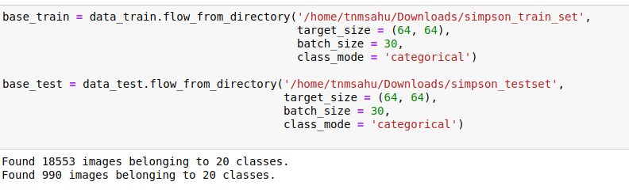

Slide 9
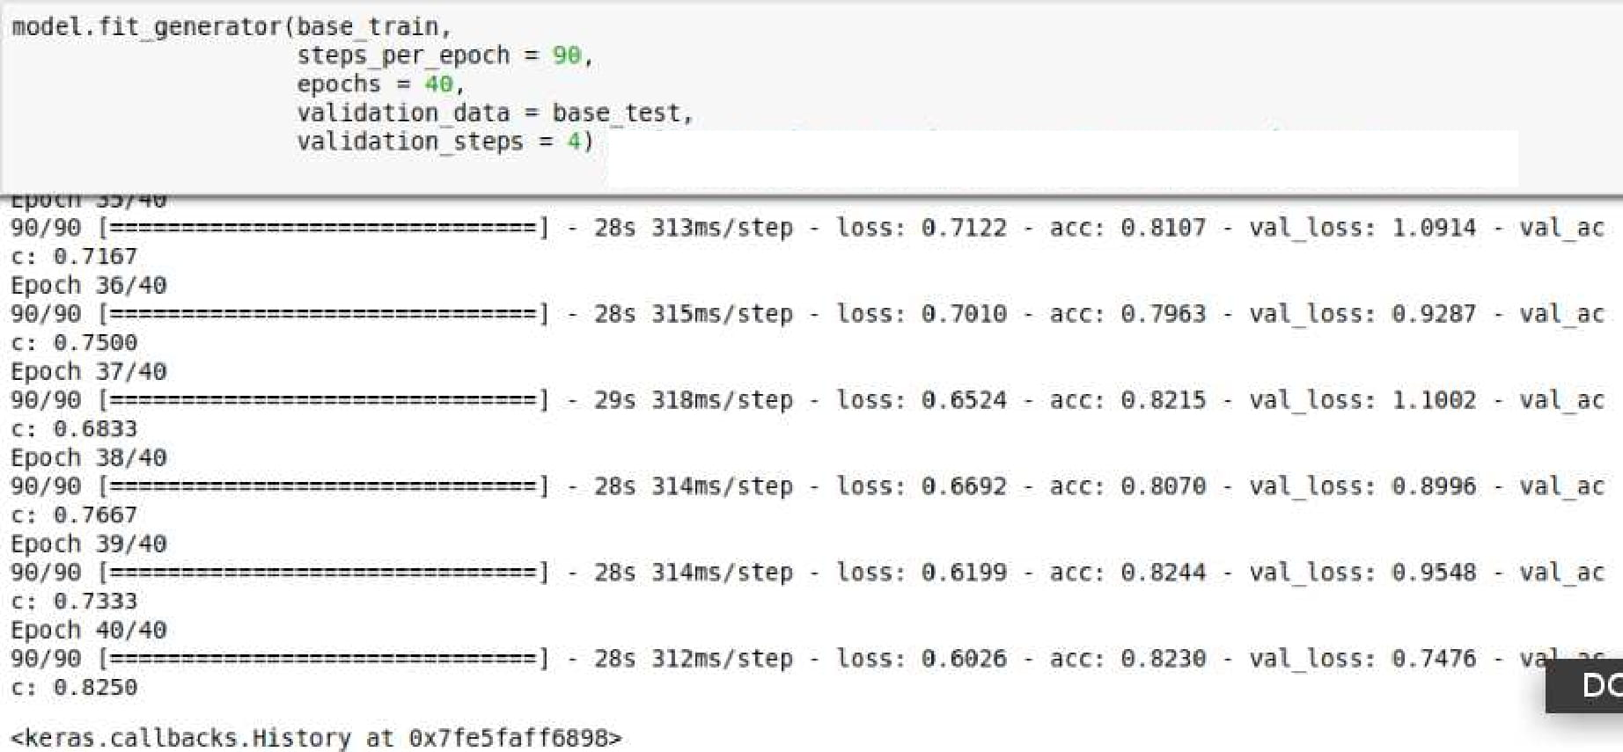
Fitting the model-

Slide 10
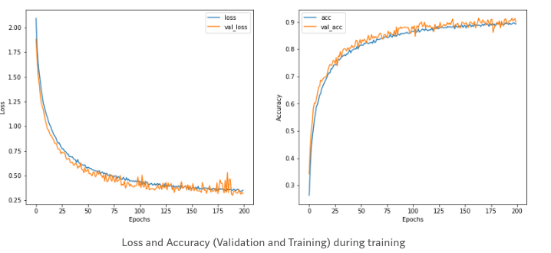
Checking whether we have overfitting or not-
It seems to have reach the asymptote, without an obvious overfitting. Moreover, the accuracy seems good too.

Slide 11
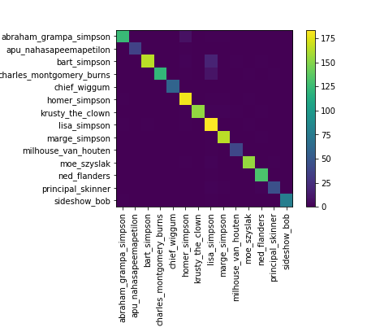
Heatmap
To check for correlation among features ,we see that Lisa is often mixed with other features.
Indeed, Lisa is often mixed up with Bart. Probably because many pictures of Lisa contain Bart too.

Slide 12
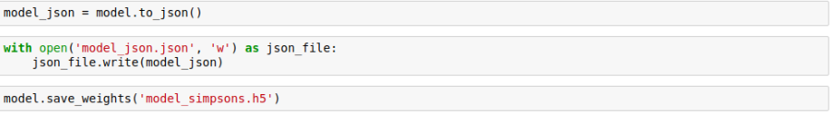
Testing the model-
Saving the model with their weights, so as to use it in future while predicting in kernel.

Slide 13
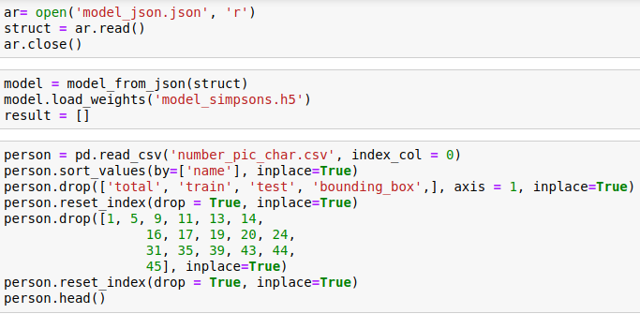
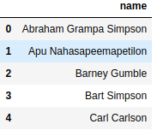
So, now we obtain the set of datas about name of characters and treat them. We can sort by the name, like in folder of datas, after it we can drop the columns total, train, test and bouding_box(as they are of no use now).

Slide 14
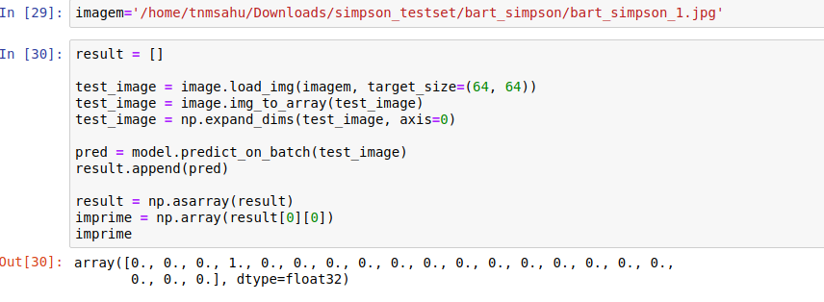
Predicting our character-

Slide 15
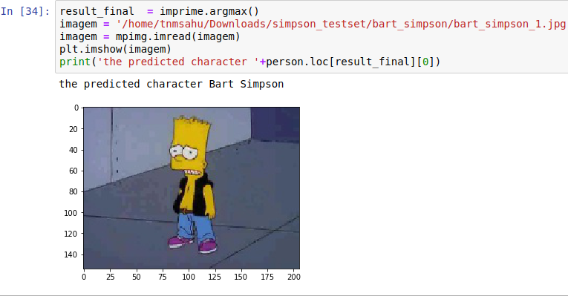
It successfully predicts the given image ,as you can see the above image.

Slide 16
APPLICATIONS-
This can be used by the makers of the show to count the number of occurences a given character & can be used by them to whether or how to use the characters better in a particular episode.

Slide 17
THANK YOU!

